Slide 1

Coca-Cola Sales Report created by Reina

Slide 2
Table Of Contents
Aim
Introduction
Problem Statements
conclusion

Slide 3

AIM
To create a report based on the dashboard regarding the Coca-Cola sales in the USA

Slide 4

Introduction
The dashboard is developed using the Coca-Cola sales dataset for the USA, covering the years 2022 and 2023.
This dataset includes detailed records of sales across various regions of the USA, categorized by retailers and beverage brands.
Additionally, the dataset also provides information on the total operating profit.

Slide 5
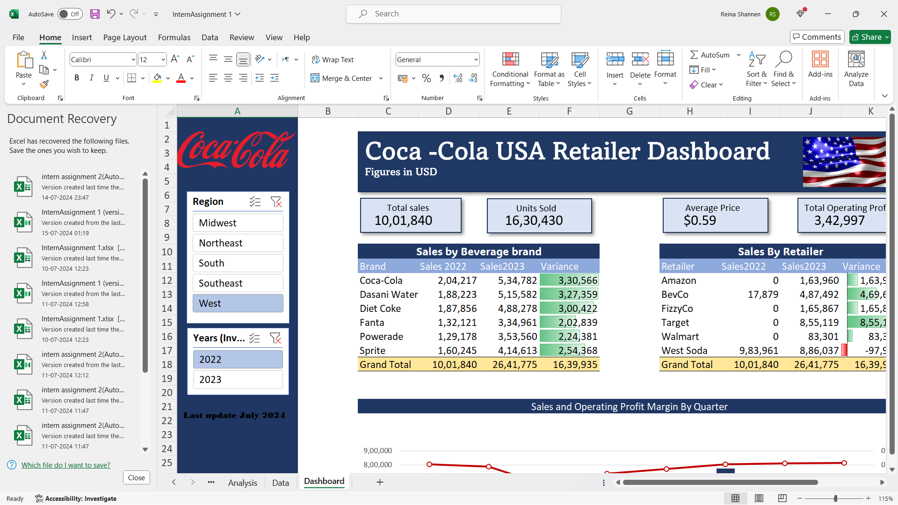

Problem 1 Which Region of the USA had the most sales in 2022 and 2023?
The West Region of the USA had a total sales of 10,01,840 in the year 2022 and a total sales of 26,41,775 in the year 2023

Slide 6
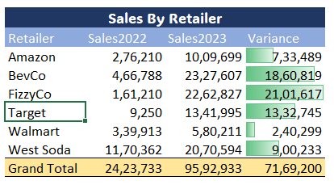
Problem 2 Which Retailer had the largest increase in sales from 2022 to 2023
‘Target’ had the largest increase in sales which went from
9,250 USD to 13,41,995 USD

Slide 7
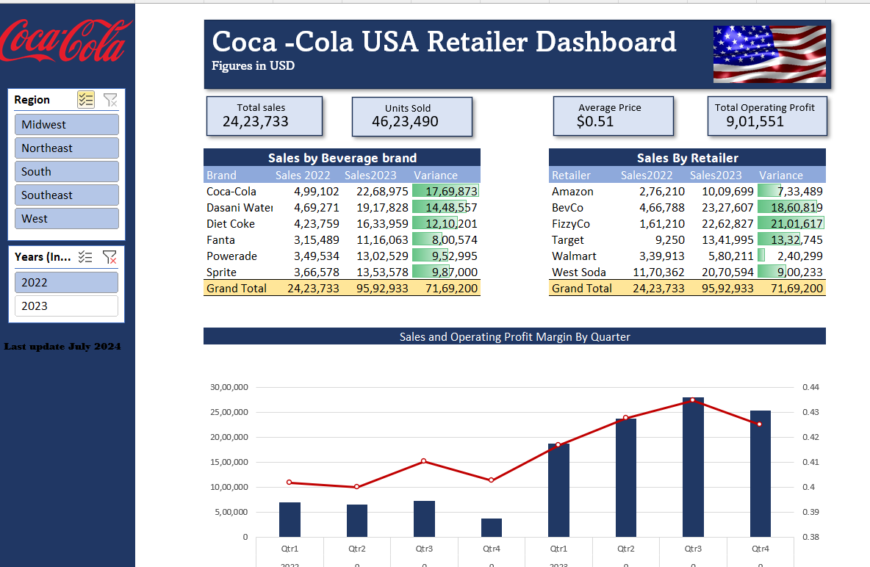
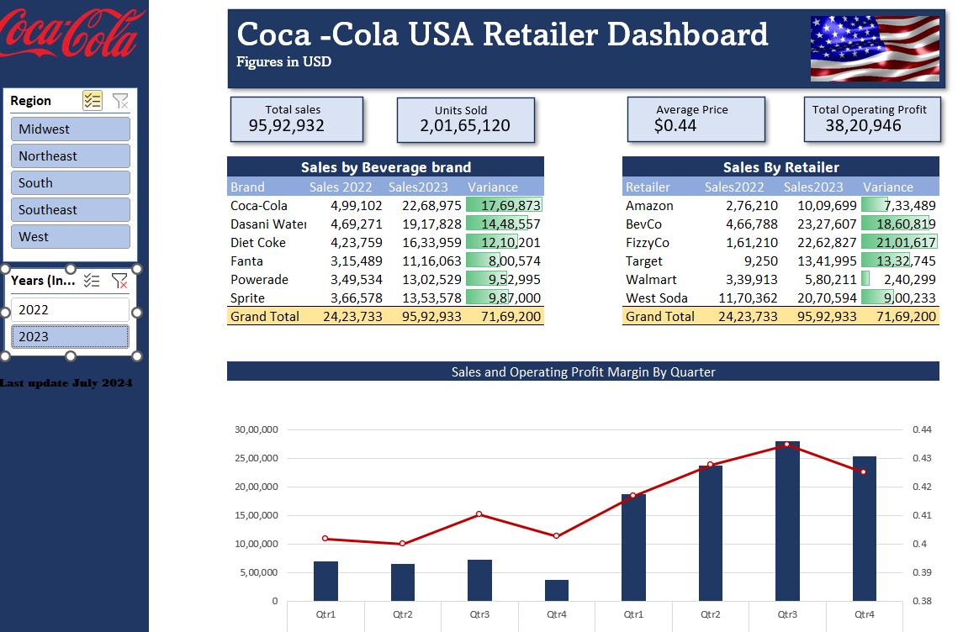
Problem 3 What is the total operating profit in the years 2022 and 2023
2022
2023
9,01,551
38,20,946

Slide 8

Problem 4 Which Beverage brand has the highest sales in 2022 & 2023
2022- 4,99,102
2023- 22,68,975

Slide 9
Conclusion
This dashboard enables the derivation of sales data across various regions of the USA and the operational profits for the years 2022 and 2023.
It also provides insights into sales based on retailers and beverage brands through visuals.
This makes it significantly easier to view and analyze various aspects of Coca-Cola's sales performance.

Slide 10
Thank you

